Slide 1
Module 12 Location Problem

Slide 2
The Prompt
Your Candy Store has been servicing your 8 storefronts, and your single DC is finally at capacity for servicing them
You want to propose a new DC location based on minimizing the Euclidean distance between each shop and the DC, luckily you now have the skills to do so
(Model Stipulation For After First Model) Your forecasters provided data on their estimates of year-over-year growth/decline for each store and want you to incorporate them into the model

Slide 3
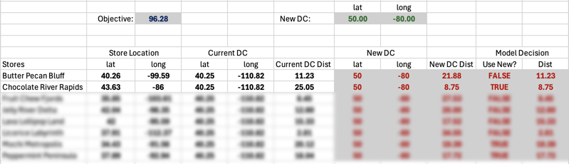
How TO Create A Working Model
Note:
Our problem set only has one “Current” DC
We are using Euclidean Distance
For ease, I am referencing the new DC latlong for each store
Our Model is choosing the coordinates of this new distribution center
Use New? Is a Formula Determining if the New DC is closer
Depending on which DC is chosen, their Dist shows up in the rightmost column
Our Objective is the SUM of the Dist in the rightmost column

Slide 4
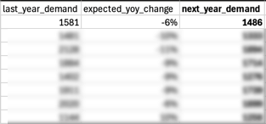
Reference for the Model Stipulation
In the Model Stipulation Section, you will need to do this calculation
Instead of Dist, we will be optimizing for the MIN of Dist * Demand (i.e. if a DC is 2 units away and it has 3000 demand, then the total added to the objective is 6000 if that DC is chosen for that store)

